Slide 1
Buckman Hackathon
Manish M

Slide 2
Contents
Problem Statement
Data Exploration
Preprocessing
Model Selection
Recommendation System
Tools and Technologies Used
Conclusion

Slide 3
Problem Statement :
The project aims to develop a robust recommendation system for investment decisions, utilizing machine learning methodologies and thorough data analysis. By delving into demographic distributions, employment particulars, and investment behaviors, the objective is to identify key factors influencing successful investment outcomes. Validation procedures will involve rigorous testing with new data samples to ensure accuracy and effectiveness, facilitating necessary refinements. The overarching goal is to empower users with tailored tools for making informed investment choices, enhancing their financial decision-making capabilities.

Slide 4
Data Exploration :
Tools Used :
PowerBI
The infographic is a comprehensive study of investment patterns, focusing on the interplay between various demographic and socioeconomic factors and their impact on investment returns. It delves into the correlation between household income and investment returns across different cities, the influence of education on investment returns, and the demographics of investors, including their distribution across cities and genders. The infographic also explores how risk levels in investment vary with experience and knowledge, and how reasons for investing differ across knowledge levels. It presents a distribution of investors across different education levels. This provides a detailed and insightful overview of the investment landscape, making me easy to find what and how the factors that contribute to making the best investment
decision.

Slide 5
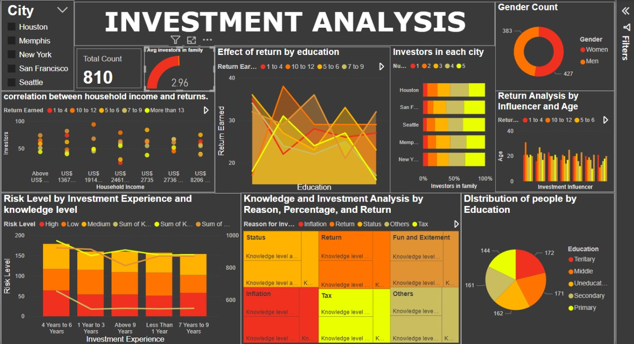

Slide 6
Preprocessing :
Preprocessing Steps:
Handling Missing Values: Replacing missing values in the "Return Earned" column.
Encoding Categorical Variables: Using one-hot encoding to convert categorical variables into numerical format.
Handling Non-numeric Values: Removing instances with "Don't Want to Reveal" in the "Percentage of Investment" column.
Dummy Encoding: Applying dummy encoding for categorical features such as city, gender, marital status, age, education, role, investment experience, investment influencer, reason for investment, risk level, percentage of investment, and source of awareness about investment.
Feature Engineering: Calculating the average knowledge level about different investment products, share market, and government schemes to create a new feature "Knowledge Level."
Extracting Numerical Values: Extracting numerical values from the "Household Income" column.
Preprocessing "Return Earned": Converting textual values in the "Return Earned" column to numerical format.

Slide 7
Preprocessing :
Data Transformation:
Removing Original Columns: Dropping the original "Household Income" column.
Final Dataset: Displaying the processed dataset with transformed features and encoded categorical variables.
Data Export:
Saving the Processed Data: Exporting the preprocessed dataset to a new Excel file named "dataset1.xlsx" for further analysis and modeling.

Slide 8
Model Selection
Model Selection:
I chose the RandomForestClassifier model for predicting risk levels based on demographic and behavioral data.
RandomForestClassifier is an ensemble learning method that builds multiple decision trees and aggregates their predictions, providing robust and accurate results.
The model is suitable for classification tasks and can handle both binary and multiclass classification problems effectively.

Slide 9
Model Selection
Why RandomForestClassifier :
I selected RandomForestClassifier due to its ability to handle high-dimensional data with numerous features, making it suitable for my dataset with multiple input variables.
The model can capture complex relationships between features and the target variable, allowing it to make accurate predictions on unseen data.
RandomForestClassifier is less prone to overfitting compared to single decision trees, providing more reliable predictions for risk levels.

Slide 10
Model Selection
Model Parameters :
RandomForestClassifier has several parameters that influence its performance, including the number of trees in the forest, maximum depth of trees, and minimum number of samples required to split a node.
I utilized the default parameters for simplicity, but these parameters can be tuned for optimal performance through techniques such as grid search or random search.
The dataset was split into training and testing sets using an 80-20 ratio to train and evaluate the model's performance, respectively.

Slide 11
Model Selection
Feature Selection :
Feature selection was performed using SelectFromModel with a median threshold, retaining the most important features for predicting risk levels.
This approach helps reduce dimensionality and computational complexity while preserving the model's predictive power.
The selected features improved model performance, resulting in higher accuracy and precision scores compared to using all features.
I have also showed how the accuracy, precision, recall and F1 score has increased by choosing the right features.

Slide 12
Recommendation System :
Users can input data interactively through dropdown menus for each column based on unique values from the training dataset.
Processed data is saved to "dataset.xlsx" and passed to a Python script for further preprocessing before model prediction.
Trained machine learning model (stored as "model.pkl") is loaded to predict the risk level of the new data.
Predicted risk level (High, Low, or Medium) is displayed to the user based on the model's prediction.

Slide 13
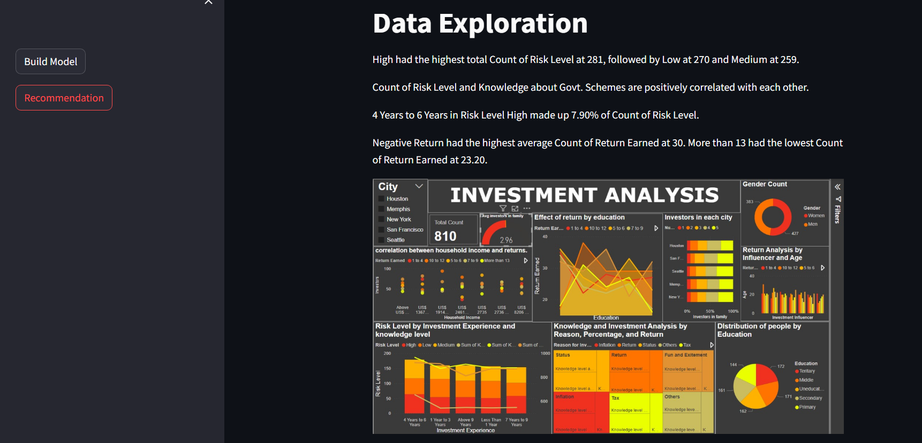
UI

Slide 14
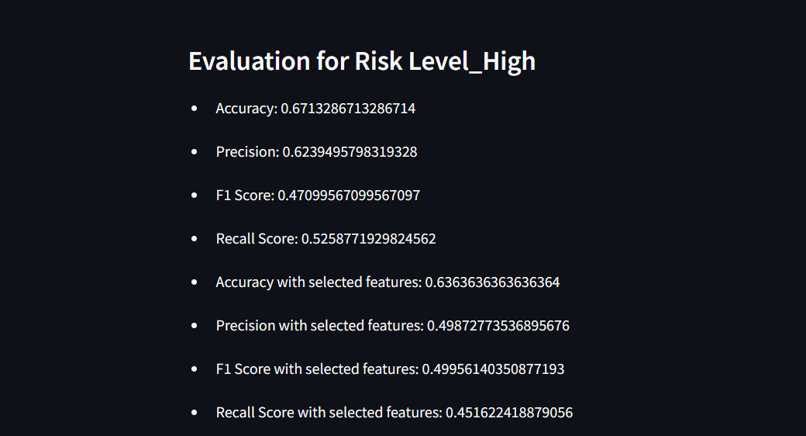

Slide 15
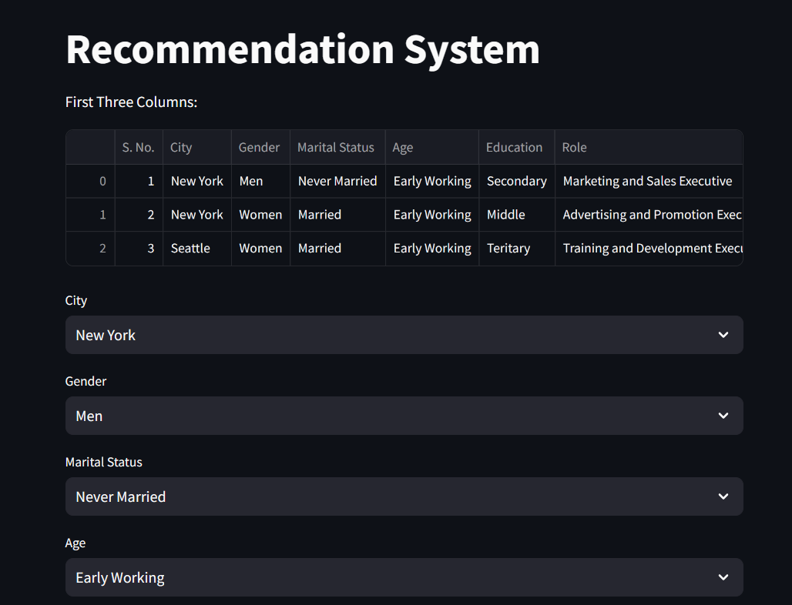

Slide 16
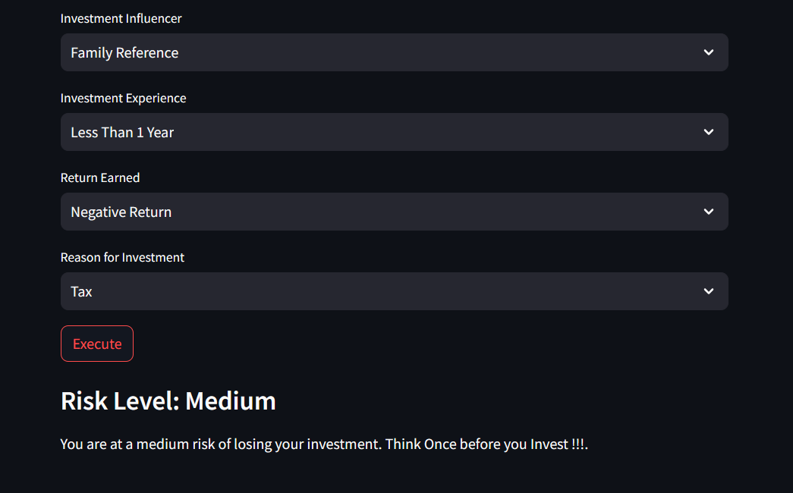

Slide 17



Tools and Technologies used :

Slide 18
Conclusion :
In conclusion, the infographic and predictive model form a robust toolkit for informed investment decisions. While the infographic reveals insightful patterns in demographic and socioeconomic factors, the predictive model forecasts risk levels and potential returns. Together, they empower investors with comprehensive insights, enhancing their ability to navigate financial complexities and make strategic investment choices confidently.

